Slide 1


visualizing the
energy transitions of countries under binding climate constraints
Babeș-Bolyai University
Cluj-Napoca | Kolozsvár
17th March 2018

Slide 2

visualizing the
energy transitions of countries under binding climate constraints
outline
Notes:
Wealthy countries could afford to do that because of fossil fuels. 2 problems with that. Depletion and global warming.

Slide 3
outline
energy
transitions
complexity
wrap-up
country results
global results
visualizing the energy transitions of countries under binding climate constraints

Slide 4
outline
energy
transitions
complexity
wrap-up
country results
global results

Slide 5
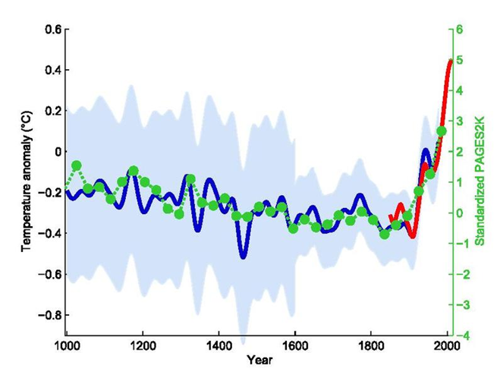



climate
Mann et al 1999
Notes:
WMO -1966 create notion for climate phenomena longer than 10 years
Mann, Bradley & Hughes 1999

Slide 6
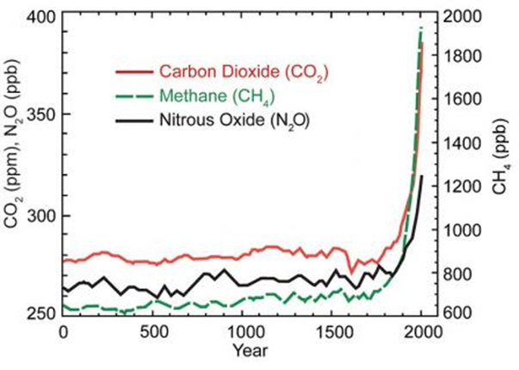
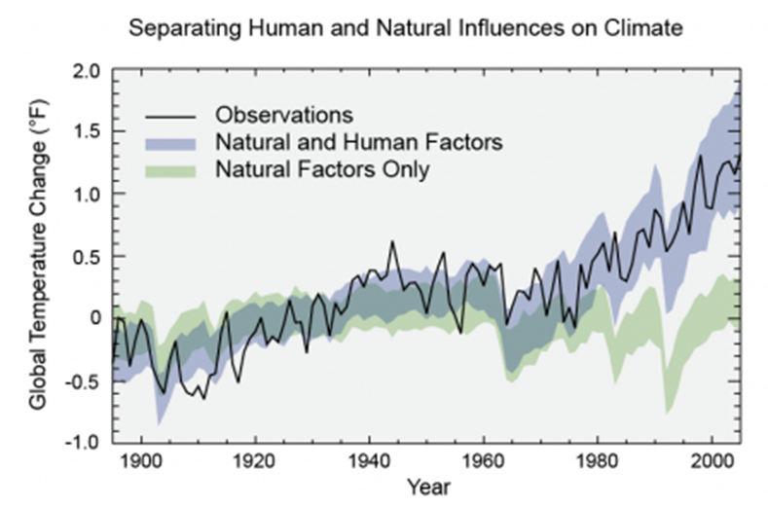


EPA, NASA
Notes:
Variations in the sun's energy reaching Earth
Changes in the reflectivity of Earth’s atmosphere and surface
Changes in the greenhouse effect, which affects the amount of heat retained by Earth’s atmosphere – this is a very delicate balance

Slide 7
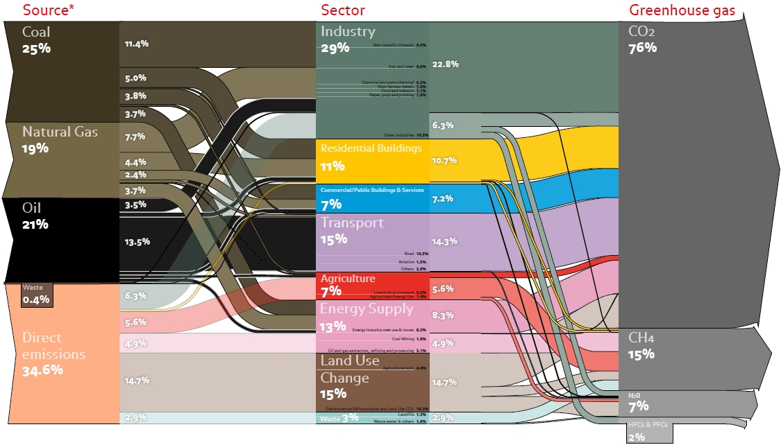



emissions
« 7 ÷ 20 »
Energy
Transitions
1
Climate Change
2
Complexity
3
Transitions
Renewables
5
6
Trilemma
Challenges
4
1
ECOFYS 2010
Lancaster
20/09/2016
ECOFYS, 2010
Notes:
ECOFYS, 2010

Slide 8
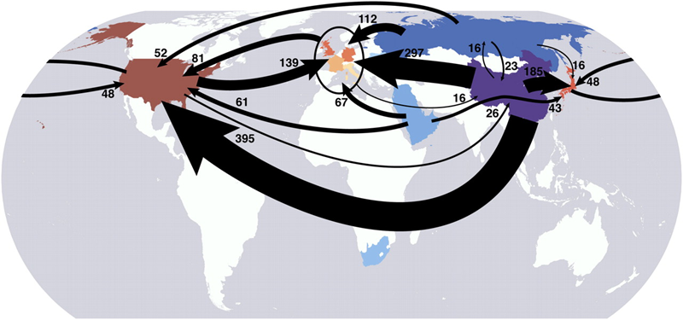
emissions
Davis & Caldeira, 2009
Notes:
Emissions distributions is a tricky thing
Need to cater for developing countries

Slide 9
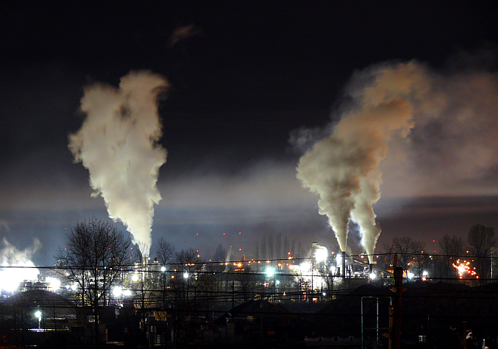
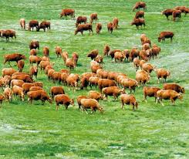
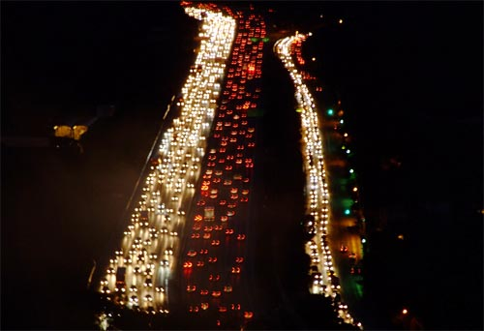
commons
Notes:
William Forster Lloyd, 1833
Garett Hardin, 1968, Science, ToC revisited

Slide 10
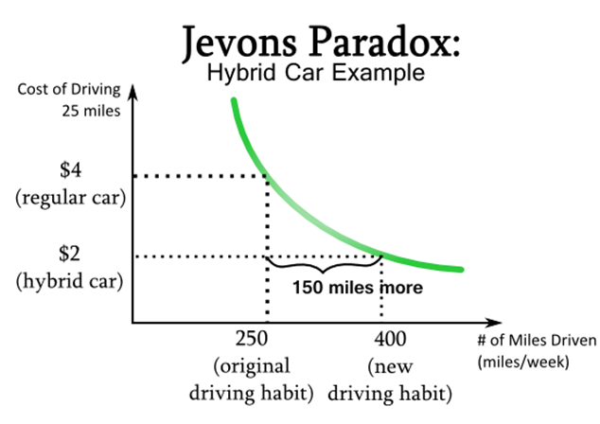
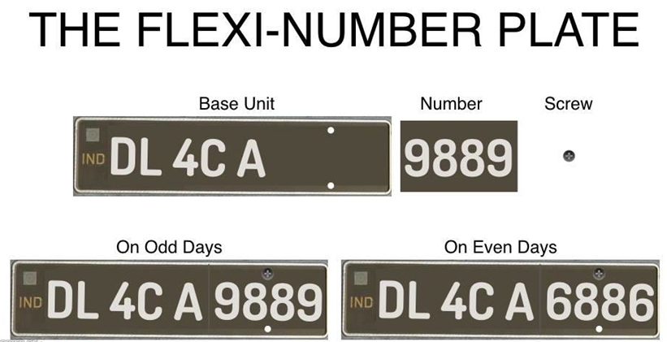
rebound
Notes:
OK you can say that efficiency will save us, costs are dropping
Enter: Jevon’s paradox – as things get cheaper, we tend to use more of them
Tell LA example of reducing emission
Then show example from Delhi

Slide 11
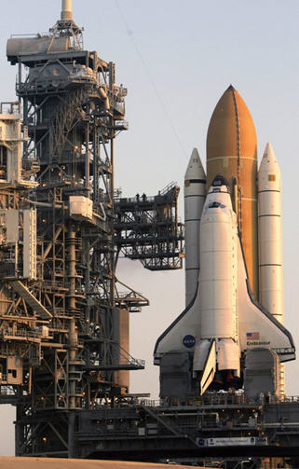
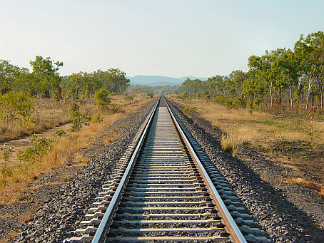
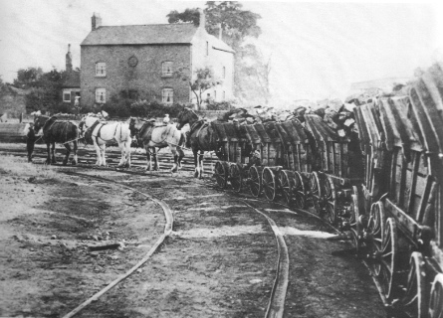
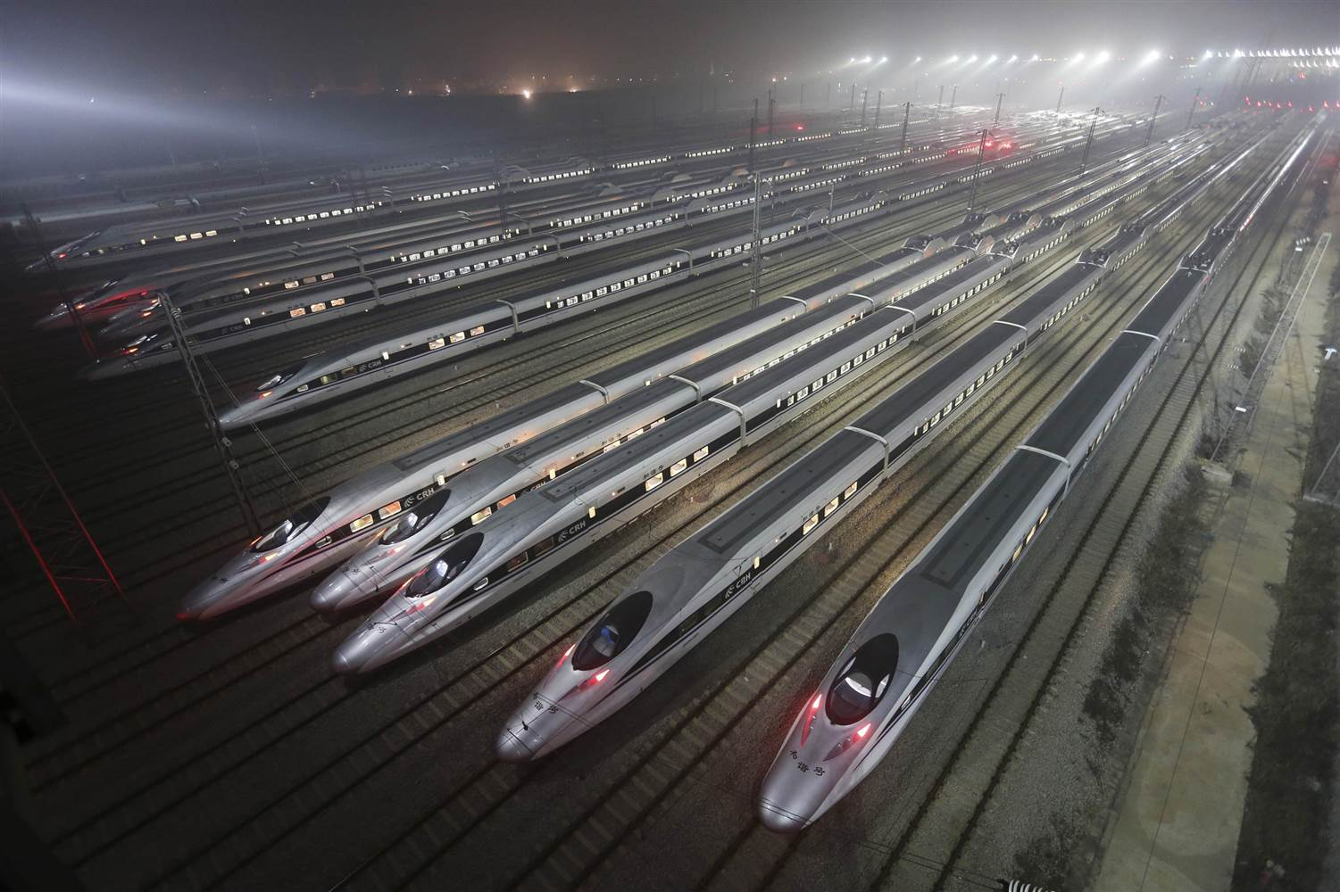
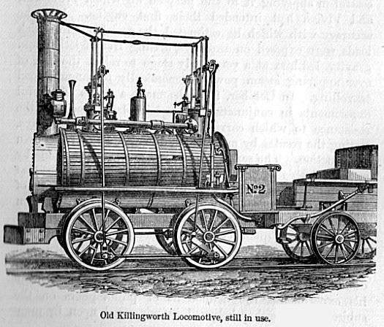
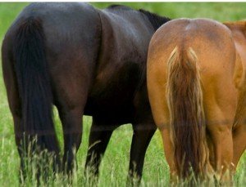
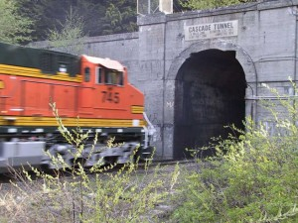
lock-in
Notes:
Lock-in
First Liv-Man line, frist intercity line in the world
Originally created carts for horse to take the coal out of the mines, easier tracktion.
http://thefrogandpenguinn.blogspot.co.uk/2011/05/update-on-two-horses-asses.html

Slide 12
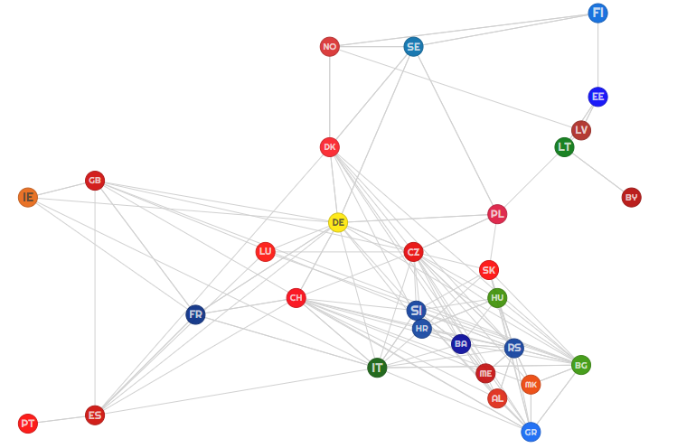
complexity
Csala, 2016
Notes:
Lock-in
First Liv-Man line, frist intercity line in the world
Originally created carts for horse to take the coal out of the mines, easier tracktion.
http://thefrogandpenguinn.blogspot.co.uk/2011/05/update-on-two-horses-asses.html

Slide 13
visualizing the
energy transitions of countries under binding climate constraints
energy
Notes:
Wealthy countries could afford to do that because of fossil fuels. 2 problems with that. Depletion and global warming.

Slide 14

energy
societal emissions modelling through the Kaya Identity (IPAT)
$$C=N\left.\left(\frac{GDP}{N}\right.\right)\left.\left(\frac{E}{GDP}\right.\right)\left.\left(\frac{C}{E}\right.\right)$$
(Chertow, 2000; Commoner, 1976; Ehrlich and Holdren, 1972; Kates, 2000)
Notes:
On top of maximizing GDP as the equivalent of social welfare, IAM’s are also very uncertain

Slide 15
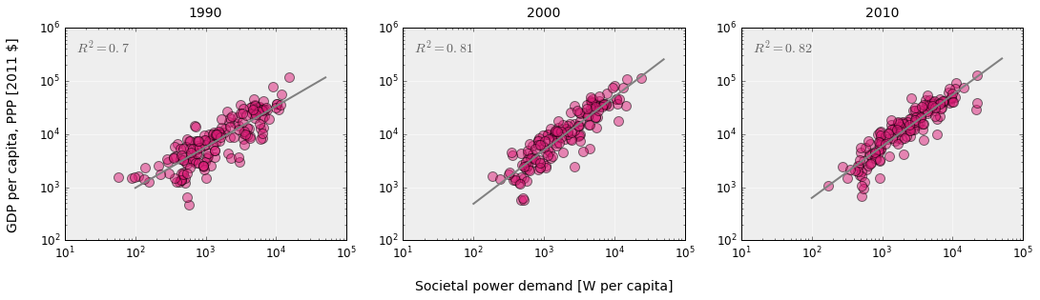
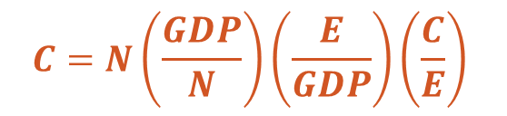
energy
$$C=N\left.\left(\frac{GDP}{N}\right.\right)\left.\left(\frac{E}{GDP}\right.\right)\left.\left(\frac{C}{E}\right.\right)$$
Own work based on open energy and GDP data from World Bank (1990-2010)
Notes:
Coalesce the second and third term into one, energy per N value

Slide 16
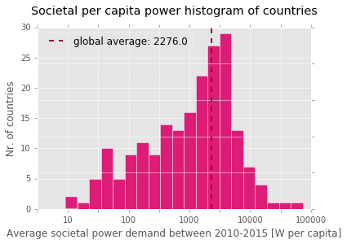
energy
~ 2300 W
Own work based on open energy and GDP data from World Bank (2010-2015)
Notes:
On top of maximizing GDP as the equivalent of social welfare, IAM’s are also very uncertain

Slide 17
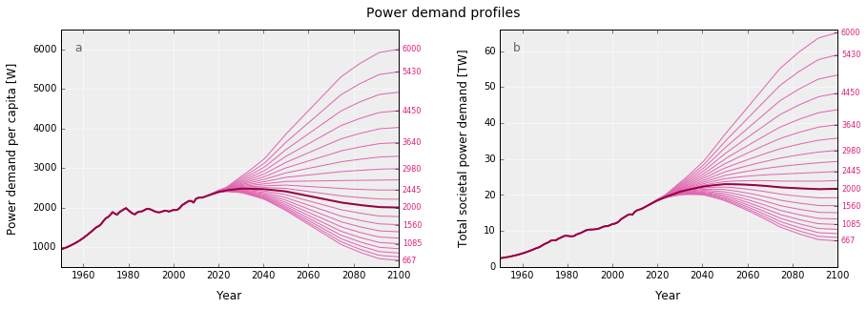
energy
Own work based on Marechal et al. (2005)
Notes:
On top of maximizing GDP as the equivalent of social welfare, IAM’s are also very uncertain

Slide 18
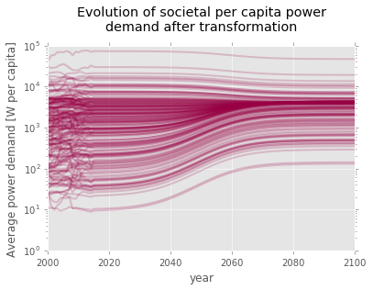
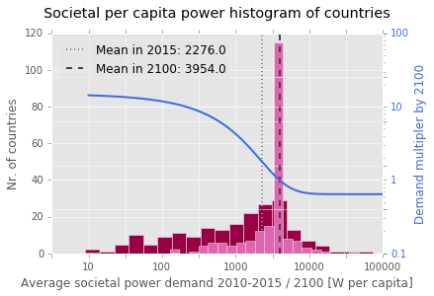
energy
Own work, data source: WDI, years: 2000-2015, own assumptions and calculations for 2100
Notes:
On top of maximizing GDP as the equivalent of social welfare, IAM’s are also very uncertain

Slide 19










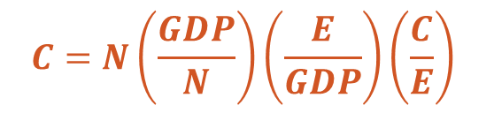
climate
1000
900
<50
gCO₂e/kWh_{e}
600
$$C=N\left.\left(\frac{GDP}{N}\right.\right)\left.\left(\frac{E}{GDP}\right.\right)\left.\left(\frac{C}{E}\right.\right)$$
IPCC AR5 WGII (2014)
Notes:
On top of maximizing GDP as the equivalent of social welfare, IAM’s are also very uncertain

Slide 20
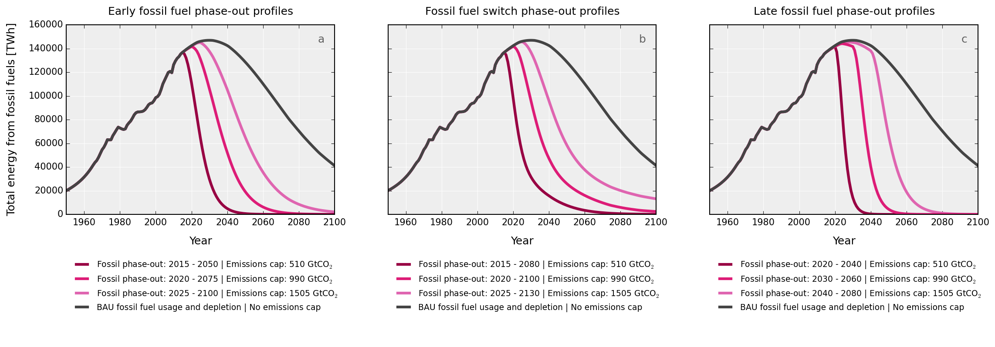
climate
990 GtCO₂
[510 – 1505]
Own work based on open energy data from EIA (1970-2040), BP (1960-2035), population data from UNSD, (1950-2100) , Maggio, Cacciola (2012), Mohr et al. (2015), IPCC AR5 WGI (2014)
Notes:
On top of maximizing GDP as the equivalent of social welfare, IAM’s are also very uncertain

Slide 21
visualizing the
energy transitions of countries under binding climate constraints
transitions
Notes:
Wealthy countries could afford to do that because of fossil fuels. 2 problems with that. Depletion and global warming.

Slide 22
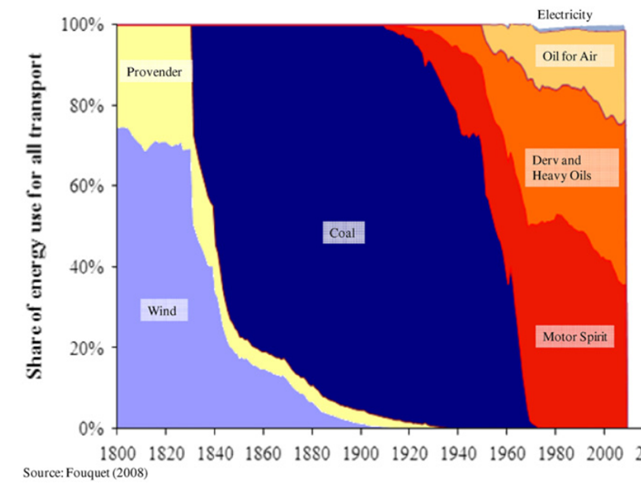
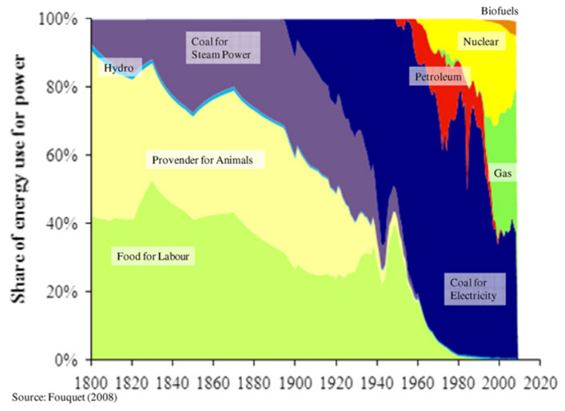
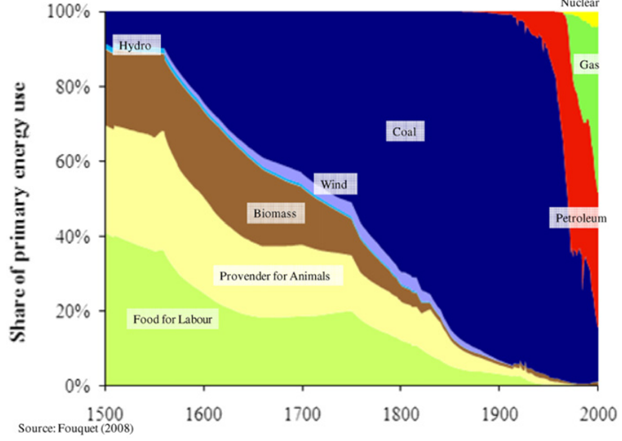
transitions
Notes:
We tend to think that wind of so new and exotic.
Wrong. It used to be 3/4res of all traportation

Slide 23
climate
990 GtCO₂
[510 – 1505]
Own work based on open energy data from EIA (1970-2040), BP (1960-2035), population data from UNSD, (1950-2100) , Maggio, Cacciola (2012), Mohr et al. (2015), IPCC AR5 WGI (2014)
Notes:
On top of maximizing GDP as the equivalent of social welfare, IAM’s are also very uncertain

Slide 24
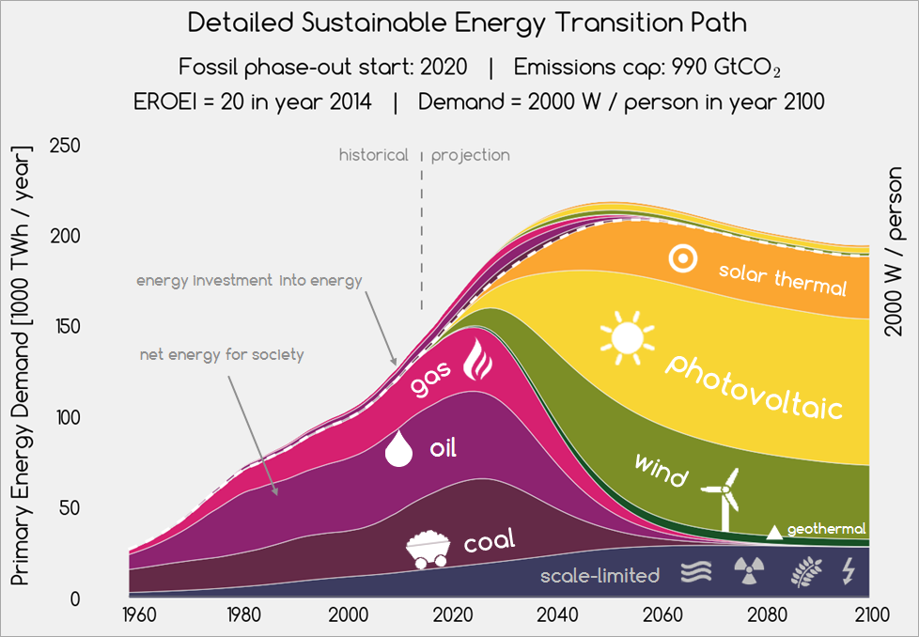
transitions
Own work based on data from, BP, EIA, UNSD, WDI, years 1960-2100, Sgouridis, Csala, Bardi (2016)
Sgouridis, Csala, Bardi (2016)
Notes:
On top of maximizing GDP as the equivalent of social welfare, IAM’s are also very uncertain

Slide 25
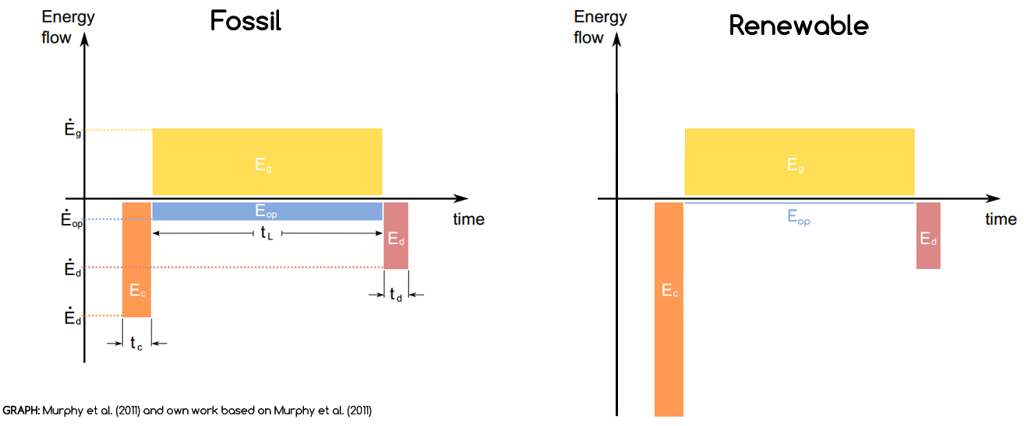
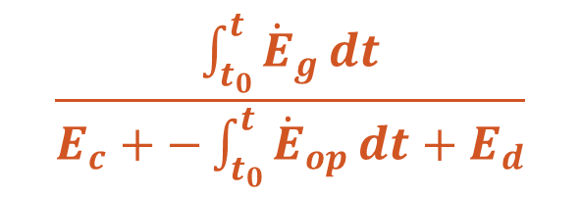
transitions
EROEI
$$\frac{\int_{t_{0}}^{t}{{\dot{E}}_{g}}dt}{E_{c}+−\int_{t_{0}}^{t}{{\dot{E}}_{op}}dt+E_{d}}$$
Murphy et al. (2011) and own work based on Murphy et al. (2011)
visualizing the energy transitions of countries under binding climate constraints
Notes:
Wealthy countries could afford to do that because of fossil fuels. 2 problems with that. Depletion and global warming.

Slide 26
transitions
Own work based on data from, BP, EIA, UNSD, WDI, years 1960-2100, Sgouridis, Csala, Bardi (2016)
Sgouridis, Csala, Bardi (2016)
Notes:
On top of maximizing GDP as the equivalent of social welfare, IAM’s are also very uncertain

Slide 27
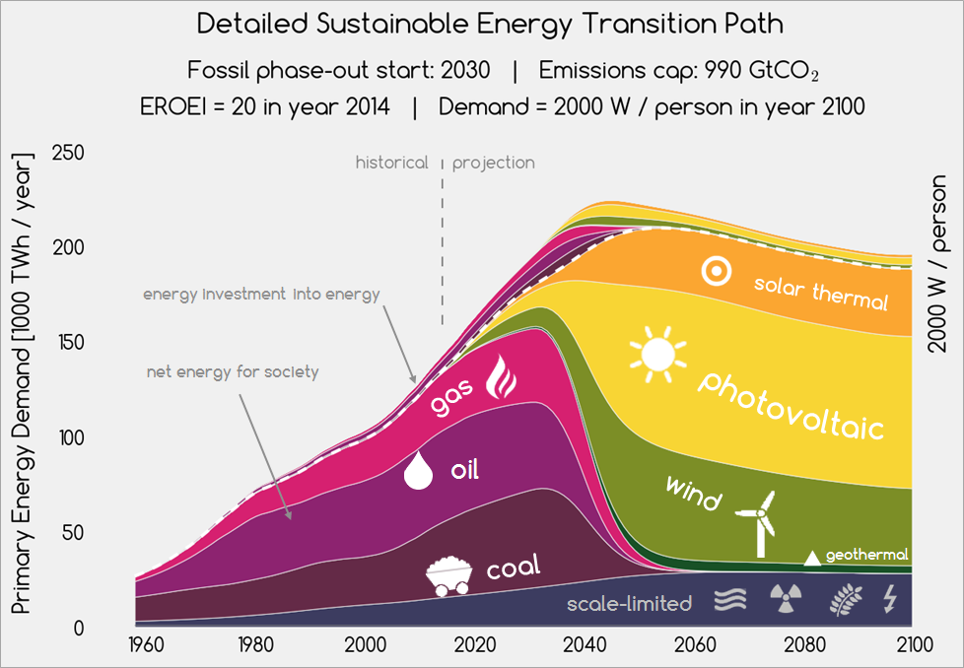
transitions
Own work based on data from, BP, EIA, UNSD, WDI, years 1960-2100, Sgouridis, Csala, Bardi (2016)
Sgouridis, Csala, Bardi (2016)
Notes:
On top of maximizing GDP as the equivalent of social welfare, IAM’s are also very uncertain

Slide 28
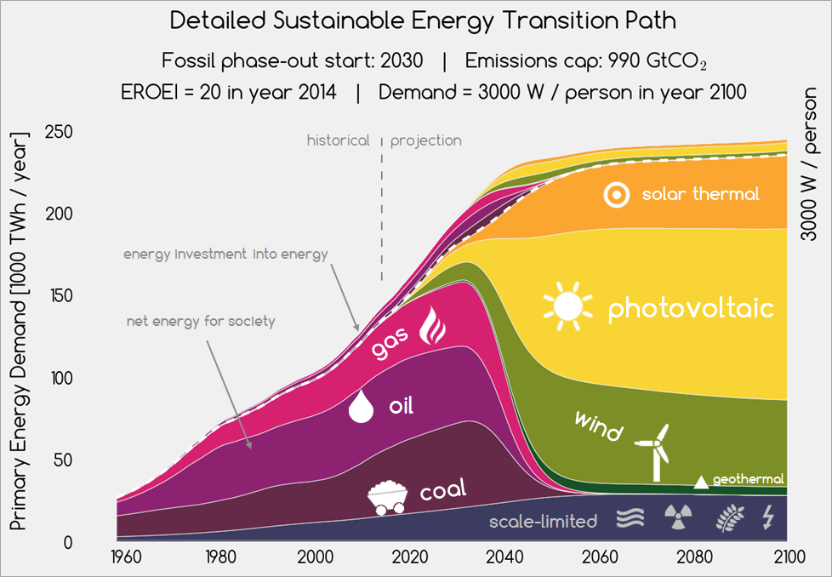
transitions
Own work based on data from, BP, EIA, UNSD, WDI, years 1960-2100, Sgouridis, Csala, Bardi (2016)
Sgouridis, Csala, Bardi (2016)
Notes:
On top of maximizing GDP as the equivalent of social welfare, IAM’s are also very uncertain

Slide 29
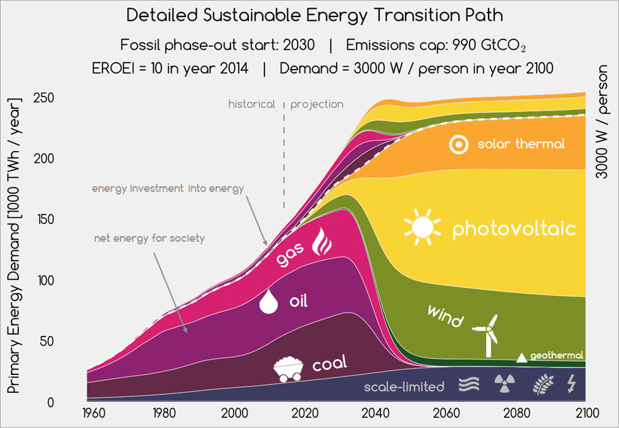
transitions
Own work based on data from, BP, EIA, UNSD, WDI, years 1960-2100, Sgouridis, Csala, Bardi (2016)
Sgouridis, Csala, Bardi (2016)
Notes:
On top of maximizing GDP as the equivalent of social welfare, IAM’s are also very uncertain

Slide 30
visualizing the
energy transitions of countries under binding climate constraints
global results
Notes:
Wealthy countries could afford to do that because of fossil fuels. 2 problems with that. Depletion and global warming.

Slide 31
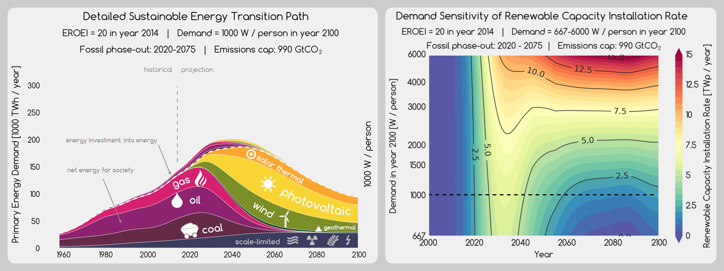
transitions
Own work based on data from, BP, EIA, UNSD, WDI, years 1960-2100, Sgouridis, Csala, Bardi (2016)
Notes:
On top of maximizing GDP as the equivalent of social welfare, IAM’s are also very uncertain

Slide 32
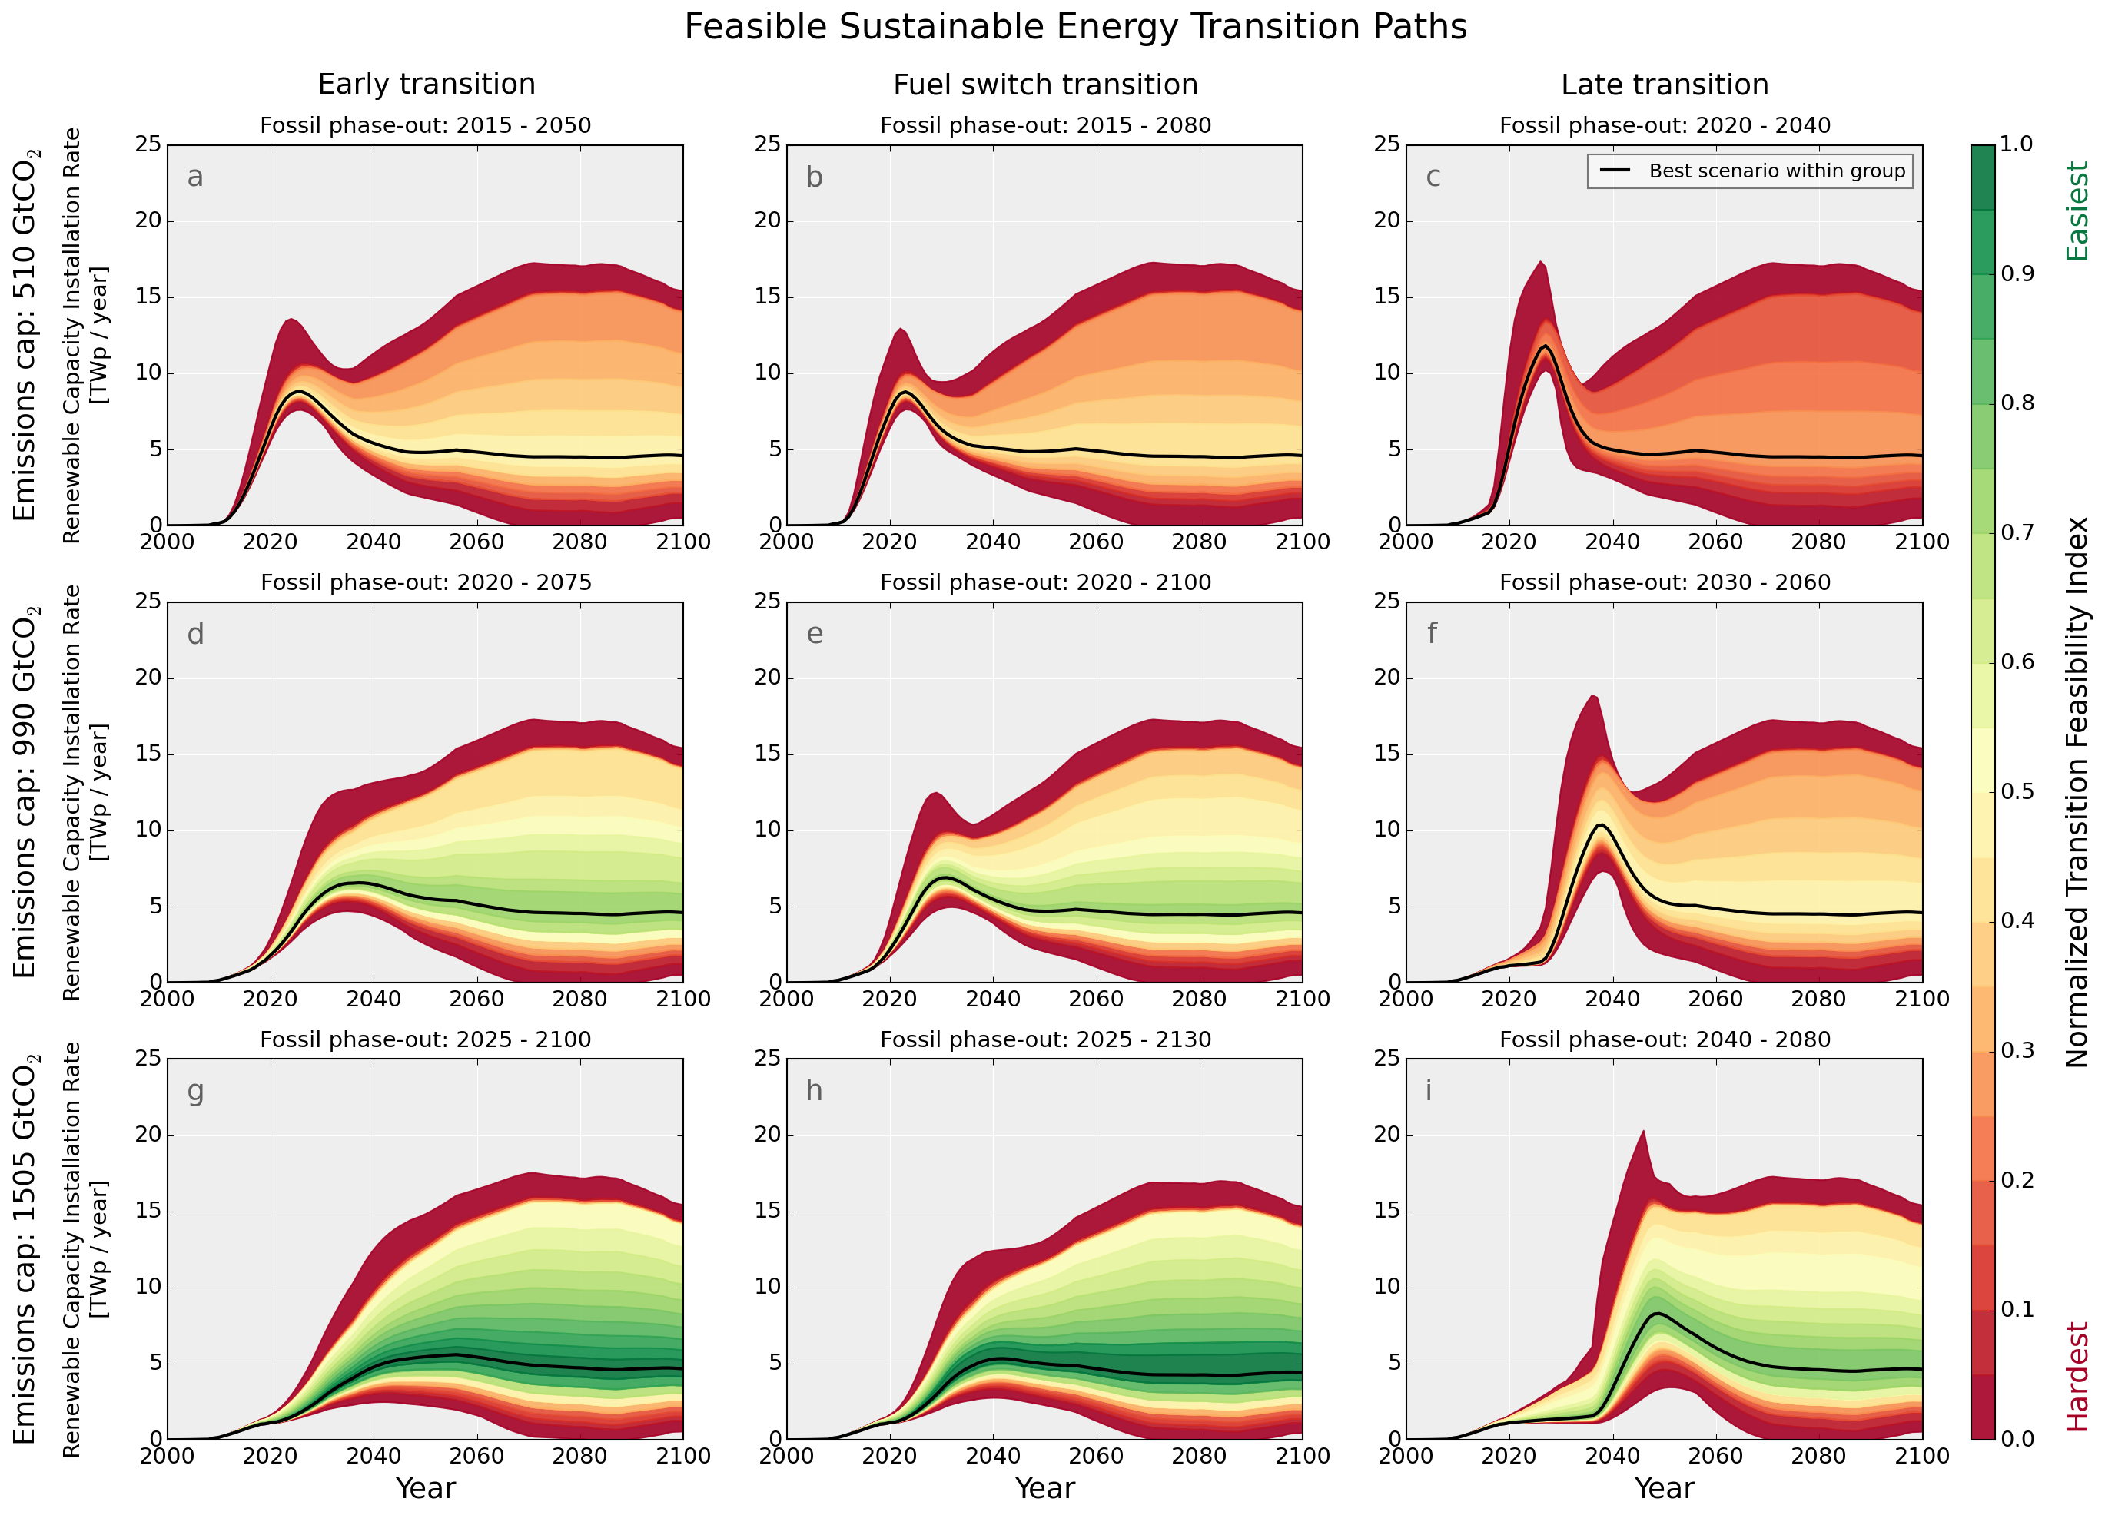
global sensitivity analysis
Feasible transition
Low investment peak
Robust to EROEI and Demand uncertainty
Low continuous investment
Envelopes are narrow during the early transition phase
Hitting the feasible region requires a 55 times increase in renewable energy installation rates within 2-3 decades
Notes:
Wealthy countries could afford to do that because of fossil fuels. 2 problems with that. Depletion and global warming.

Slide 33
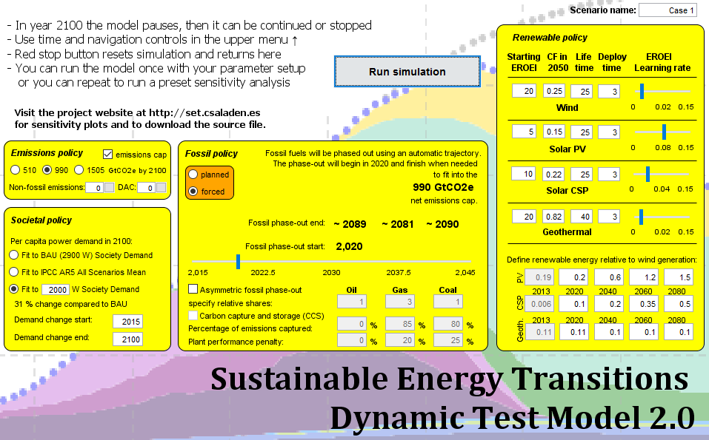
global sensitivity analysis
https://runthemodel.com/models/2104/
Notes:
Wealthy countries could afford to do that because of fossil fuels. 2 problems with that. Depletion and global warming.

Slide 34
visualizing the
energy transitions of countries under binding climate constraints
country results
Notes:
Wealthy countries could afford to do that because of fossil fuels. 2 problems with that. Depletion and global warming.

Slide 35
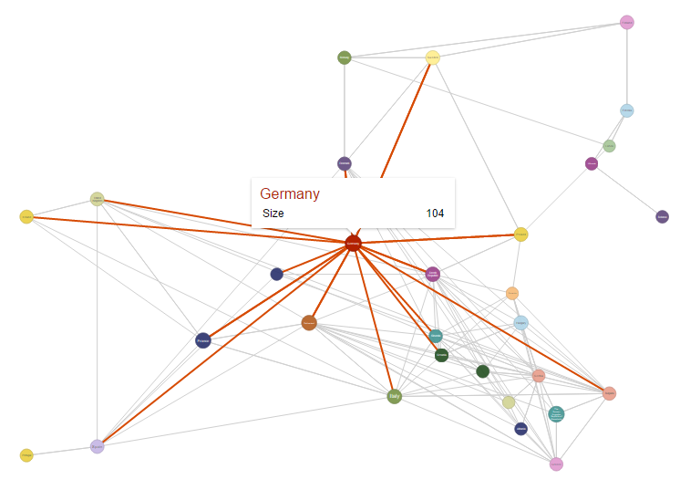
trade network
Collect historical trade data on fossil fuels and electricity from the UN COMTRADE database
Collect historical price data from World Bank Commodities database
Create historical energy trade flow networks
2015 electricity trade network of Europe
Own work based on data from UN COMTRADE, and WDC
Notes:
Wealthy countries could afford to do that because of fossil fuels. 2 problems with that. Depletion and global warming.

Slide 36
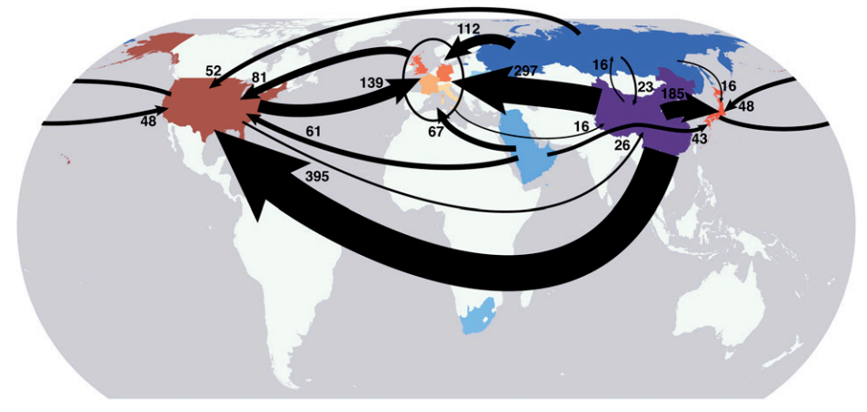
embedded emissions in trade
Davis and Caldeira (2010)
Notes:
Wealthy countries could afford to do that because of fossil fuels. 2 problems with that. Depletion and global warming.

Slide 37
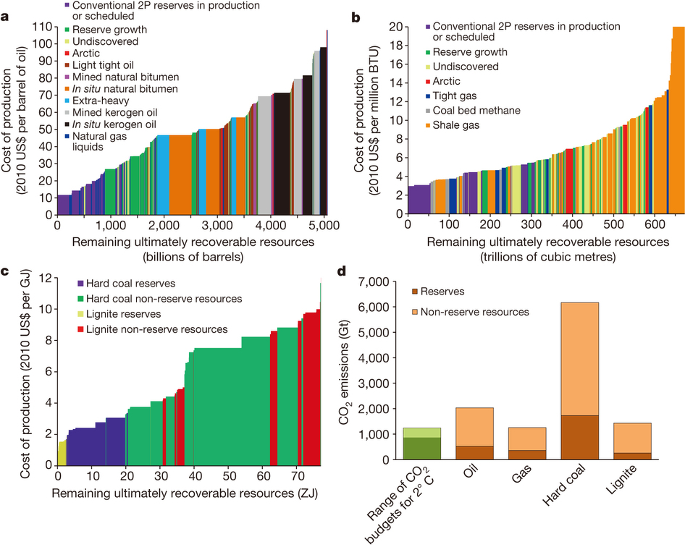
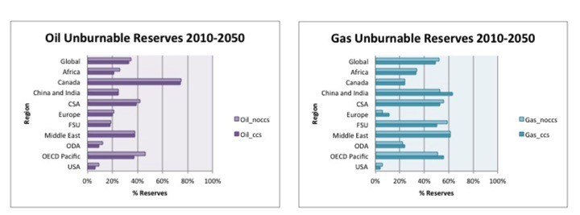
unburnable reserves
McGlade and Ekins (2015)
Notes:
Wealthy countries could afford to do that because of fossil fuels. 2 problems with that. Depletion and global warming.

Slide 38
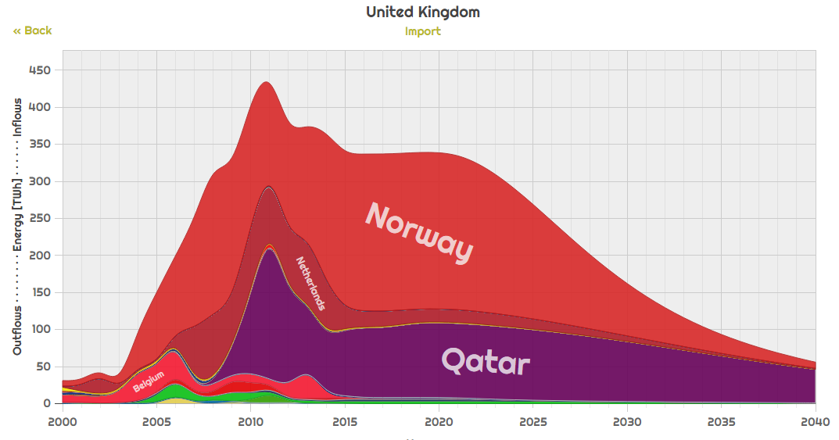

fossil phase-out
http://netset.csaladen.es
NETSET Exploratorium, Csala (2016)
Notes:
Wealthy countries could afford to do that because of fossil fuels. 2 problems with that. Depletion and global warming.

Slide 39
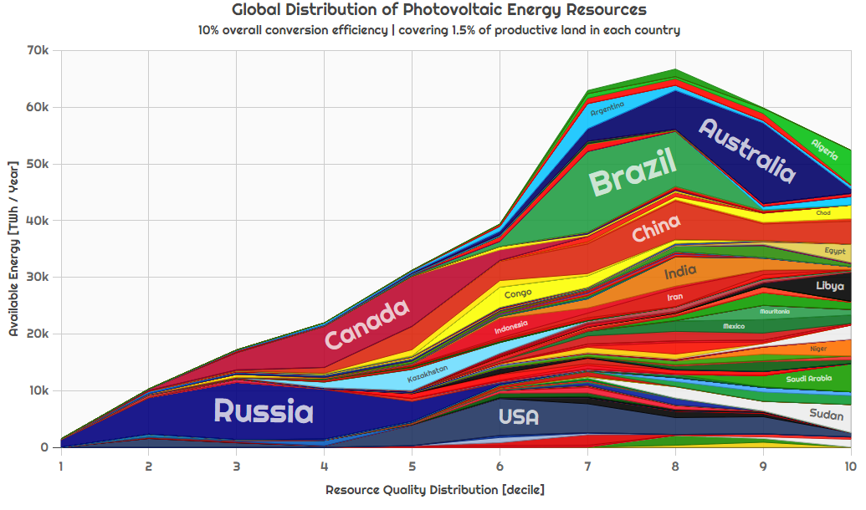
resource distribution
http://netset.csaladen.es
NETSET Exploratorium, Csala (2016)
Notes:
Wealthy countries could afford to do that because of fossil fuels. 2 problems with that. Depletion and global warming.

Slide 40
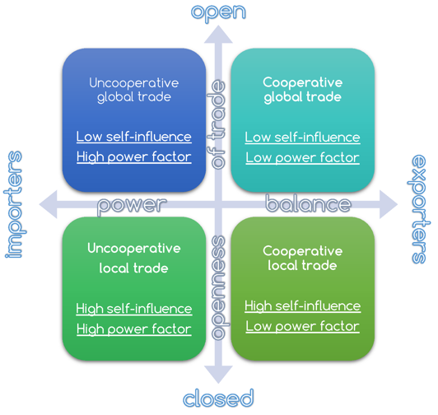
http://www.csaladen.es/doc/Denes_NETSET_process_diagram.pdf
NETSET Exploratorium, Csala (2016)
Notes:
Wealthy countries could afford to do that because of fossil fuels. 2 problems with that. Depletion and global warming.

Slide 41
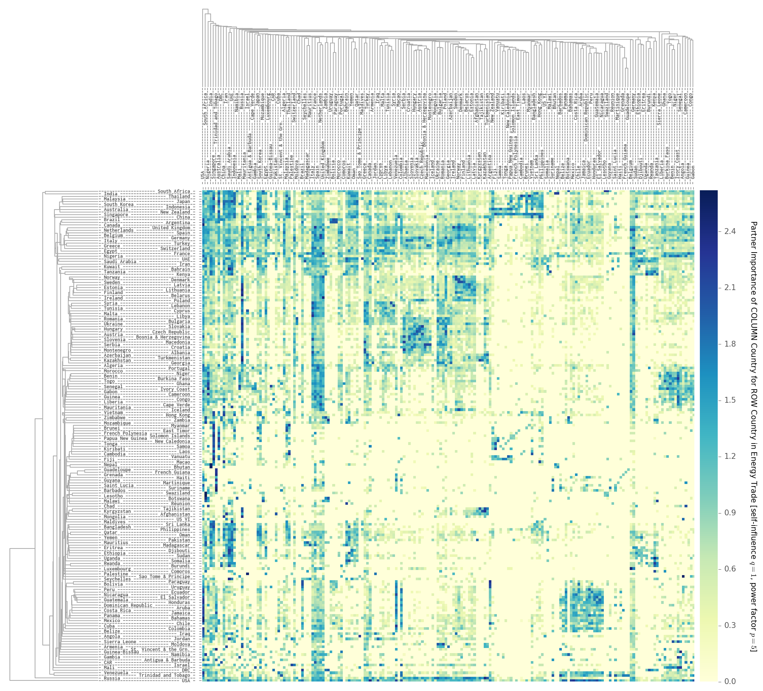
trade cost
NETSET Exploratorium, Csala (2016)
Notes:
Wealthy countries could afford to do that because of fossil fuels. 2 problems with that. Depletion and global warming.

Slide 42
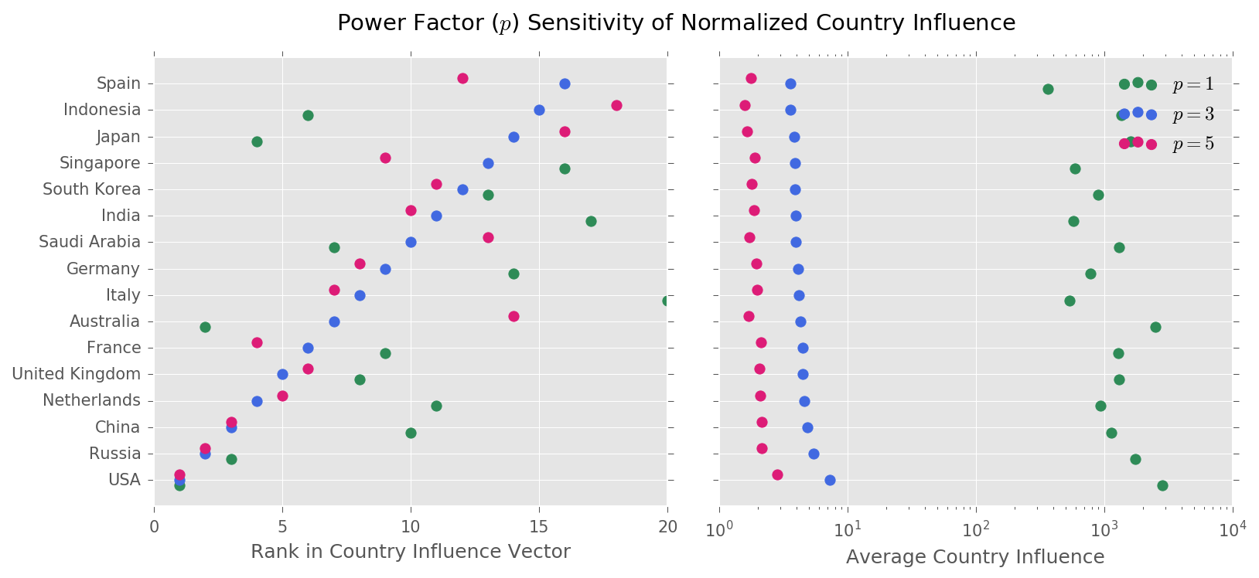
country influence vector
NETSET Exploratorium, Csala (2016)
Notes:
Wealthy countries could afford to do that because of fossil fuels. 2 problems with that. Depletion and global warming.

Slide 43
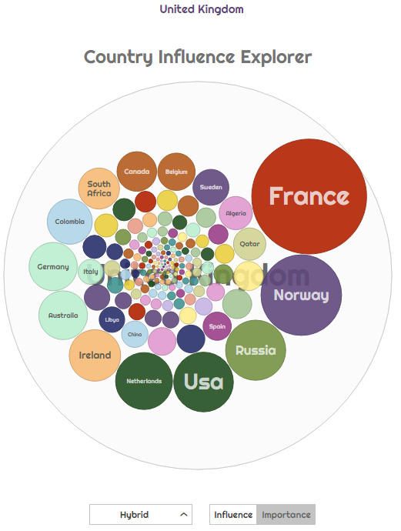
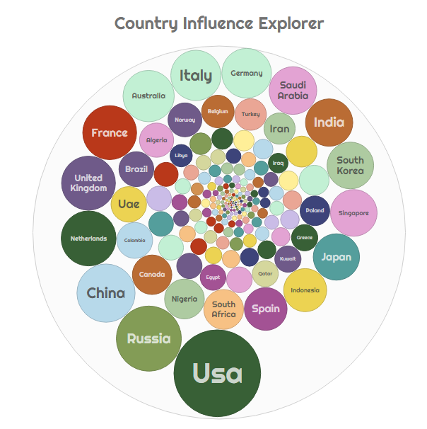
country influence explorer
http://netset.csaladen.es /bubbles.html
NETSET Exploratorium, Csala (2016)
Notes:
Wealthy countries could afford to do that because of fossil fuels. 2 problems with that. Depletion and global warming.

Slide 44
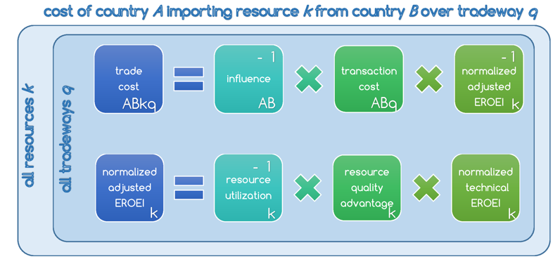
trade cost allocation algorithm
NETSET Exploratorium, Csala (2016)
Notes:
Wealthy countries could afford to do that because of fossil fuels. 2 problems with that. Depletion and global warming.

Slide 45

trade cost allocation algorithm
NETSET Exploratorium, Csala (2016)
http://www.csaladen.es/doc/Denes_NETSET_process_diagram.pdf
Notes:
Iterations

Slide 46

country results
http://netset.csaladen.es
NETSET Exploratorium, Csala (2016)
Notes:
Balance plot
Coal
Gas

Slide 47
visualizing the
energy transitions of countries under binding climate constraints
wrap-up
Notes:
Wealthy countries could afford to do that because of fossil fuels. 2 problems with that. Depletion and global warming.

Slide 48



Climate Interactive (2016), image source: Huffington Post
Notes:
Garrett Hardin

Slide 49











recap
Notes:
Remember:
-the organizations
-Earth’s gases are in a delicate balance
-emission mostly come from energy
-hard to distribute because of trade and past
-stranded assets and lock-in effects make it even harder
-transitions also take time, especially for renewables

Slide 50


“Look beyond the horizon, so that you can see the island you are going to. Especially because you have never been there, you have to see that island in your mind, or else you can never get there…”
Mau Pilaung (Polynesian master navigator) to Nainoa Thompson (first Hawaiian to repeat the voyage) – adapted from Sgouris Sgouridis
Notes:
Polynesian sailors have rouotinely navigated 4000 kilometers, from Tahiti to Hawaii, without any western instrments for survival

Slide 51
visualizing the
energy transitions of countries under binding climate constraints
Babeș-Bolyai University
Cluj-Napoca | Kolozsvár
17th March 2018
Thank you!

